Slide 1
Computing smooth surface contours with accurate topology
Pierre Bénard
Aaron Hertzmann
Michael Kass

Slide 2
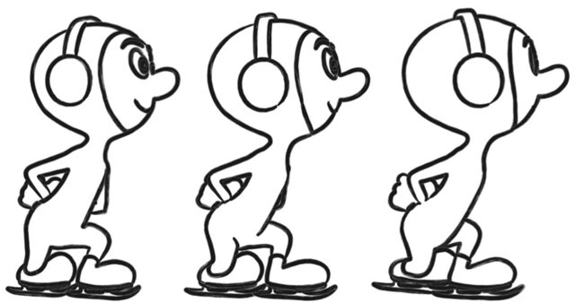
Problem

Slide 3
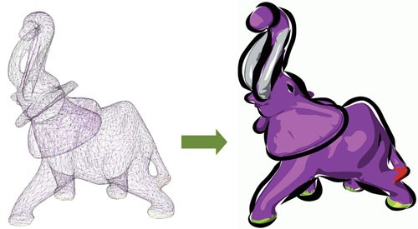
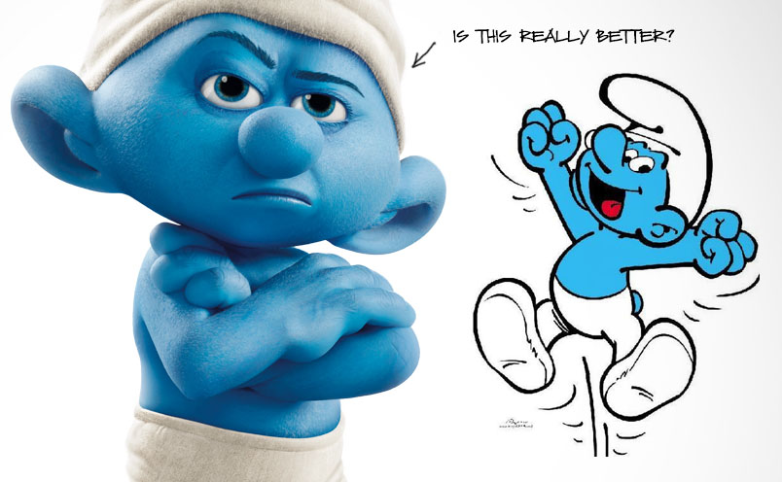
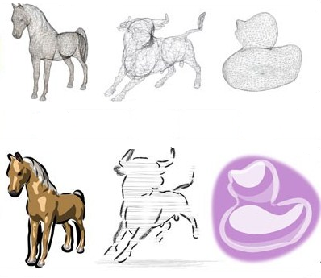
Motivation: Stylized contours

Slide 4


Slide 5


Slide 6
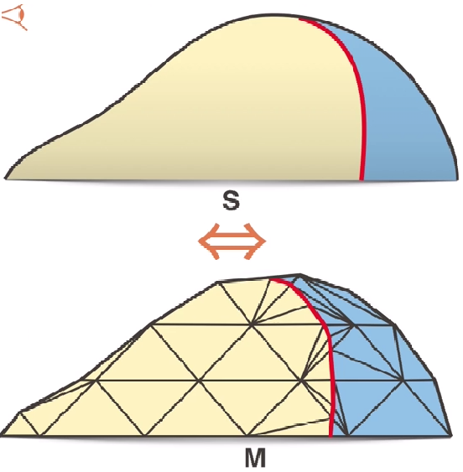
The method

Slide 7
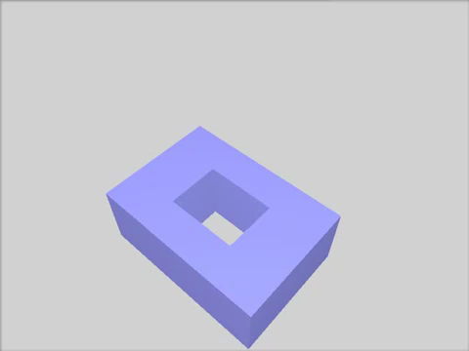
Catmull-Clark subdivision surface

Slide 8
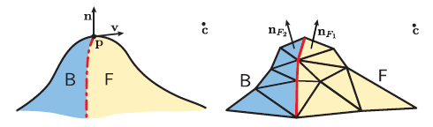
Contour generator and contour

Slide 9
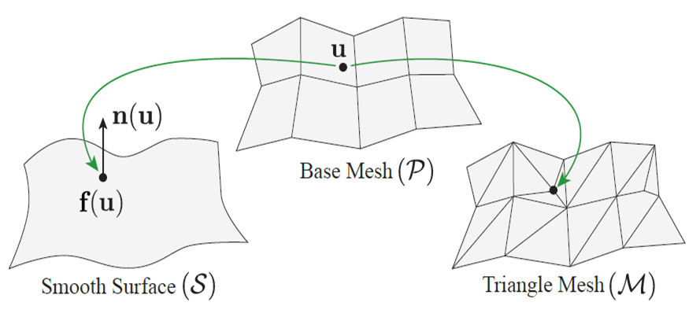
Orientation

Slide 10
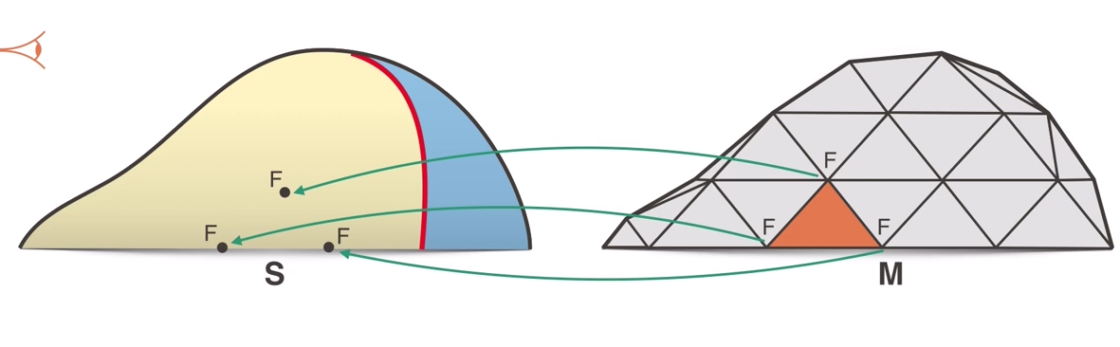
Vertex-Based orientation VBO

Slide 11
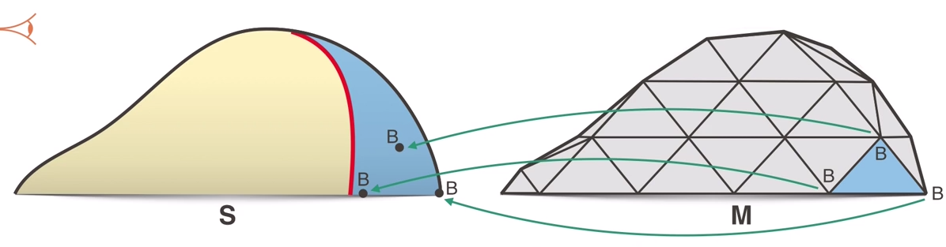
Vertex-Based orientation VBO

Slide 12
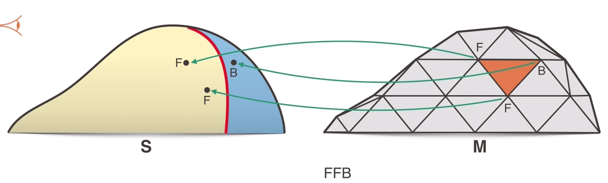
Contour consistent
A face in M is contour consistent if and only if its VBO is defined and equal to the face`s orientation.

Slide 13
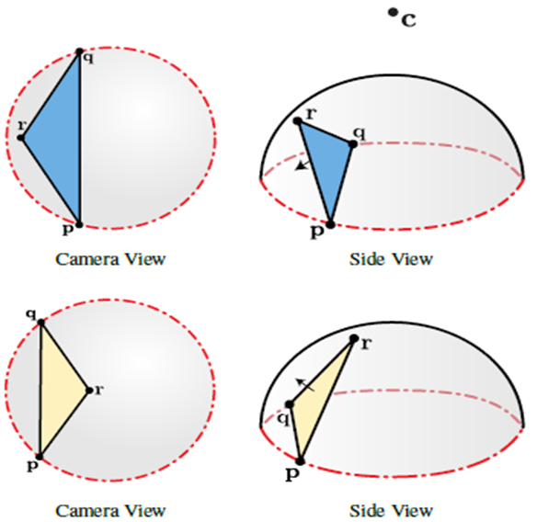
Contour-consistent

Slide 14
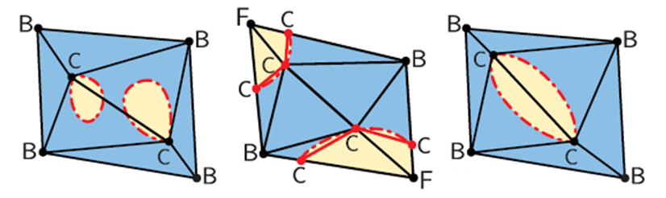
Degenerate edge
An edge in M es degenerate if and only if it has two contour vertices CC, and the edge is shared by two triangles with the same VBO

Slide 15
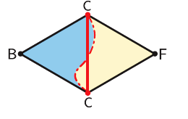
Strongly contour consistent
A face in M is strongly contour consistent if
It is contour consistent
Every edge that is incident on an F or B vertex, there are no contour points.

Slide 16
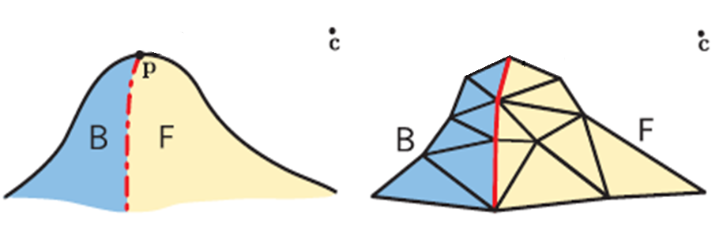
Theorem
If each triangle is Strongly Contour- Consistent, and no edges are degenerate then the orientations of the mesh faces form a partition of the surface into front-facing and back-facing regions that is isotopic to the orientation S.

Slide 17
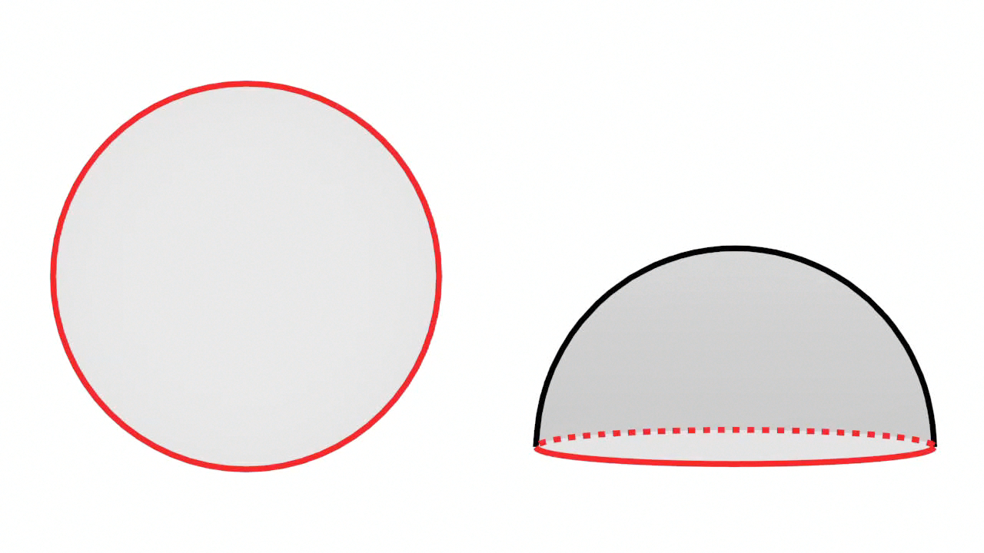
Radial triangles

Slide 18
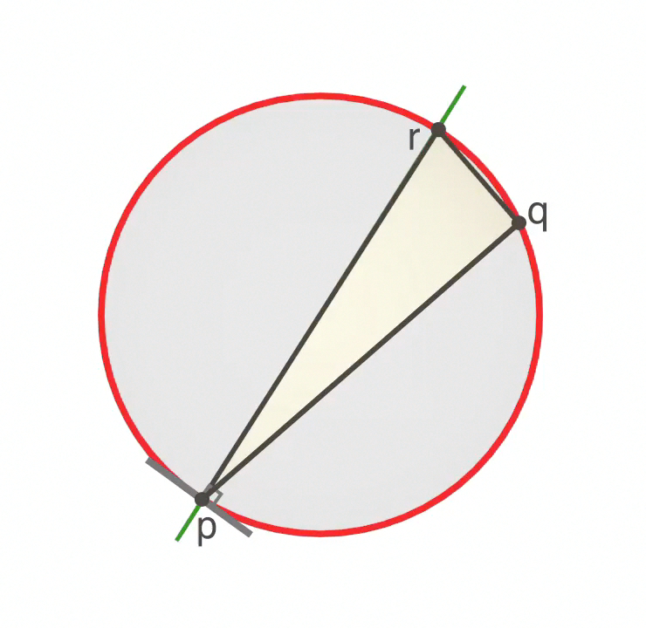
Radial triangles

Slide 19
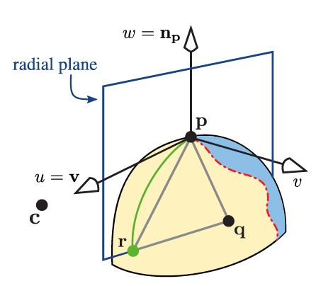
Radial triangles
A radial triangle is a triangle with one vertex p on the contour, and another vertex r on the radial plane of p.

Slide 20
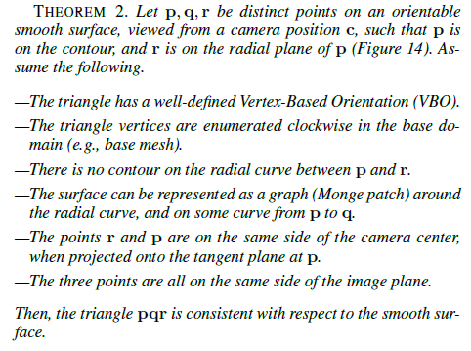

Slide 21
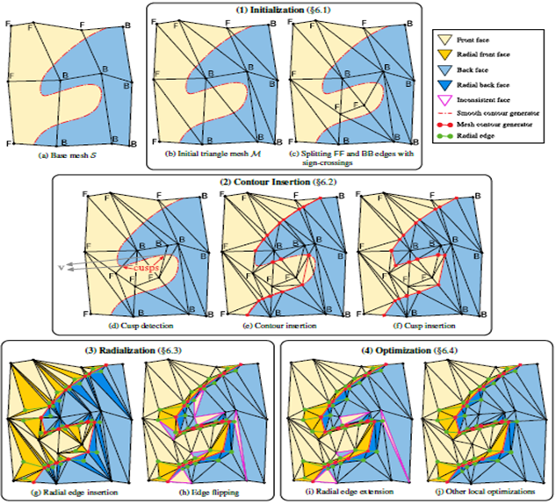
For the next time

